Slide 1

1. Deuteronomy 28: 1 to 14 say:And it shall come to pass, if thou shalt hearken diligently unto the voice of the LORD thy God, to observe and to do all his commandments which I command thee this day, that the LORD thy God will set thee on high above all nations of the earth:
And all these blessings shall come on thee, and overtake thee, if thou shalt hearken unto the voice of the LORD thy God.
Blessed shalt thou be in the city, and blessed shalt thou be in the field.
Blessed shall be the fruit of thy body, and the fruit of thy ground, and the fruit of thy cattle, the increase of thy kine, and the flocks of thy sheep.

Slide 2
Blessed shall be thy basket and thy store.
Blessed shalt thou be when thou comest in, and blessed shalt thou be when thou goest out.
The LORD shall cause thine enemies that rise up against thee to be smitten before thy face: they shall come out against thee one way, and flee before thee seven ways.
The LORD shall command the blessing upon thee in thy storehouses, and in all that thou settest thine hand unto; and he shall bless thee in the land which the LORD thy God giveth thee.
The LORD shall establish thee an holy people unto himself, as he hath sworn unto thee, if thou shalt keep the commandments of the LORD thy God, and

Slide 3
walk in his ways.
And all people of the earth shall see that thou art called by the name of the LORD; and they shall be afraid of thee.
And the LORD shall make thee plenteous in goods, in the fruit of thy body, and in the fruit of thy cattle, and in the fruit of thy ground, in the land which the LORD sware unto thy fathers to give thee.
The LORD shall open unto thee his good treasure, the heaven to give the rain unto thy land in his season, and to bless all the work of thine hand: and thou shalt lend unto many nations, and thou shalt not borrow.
And the LORD shall make thee the head, and not the tail; and thou shalt be above

Slide 4
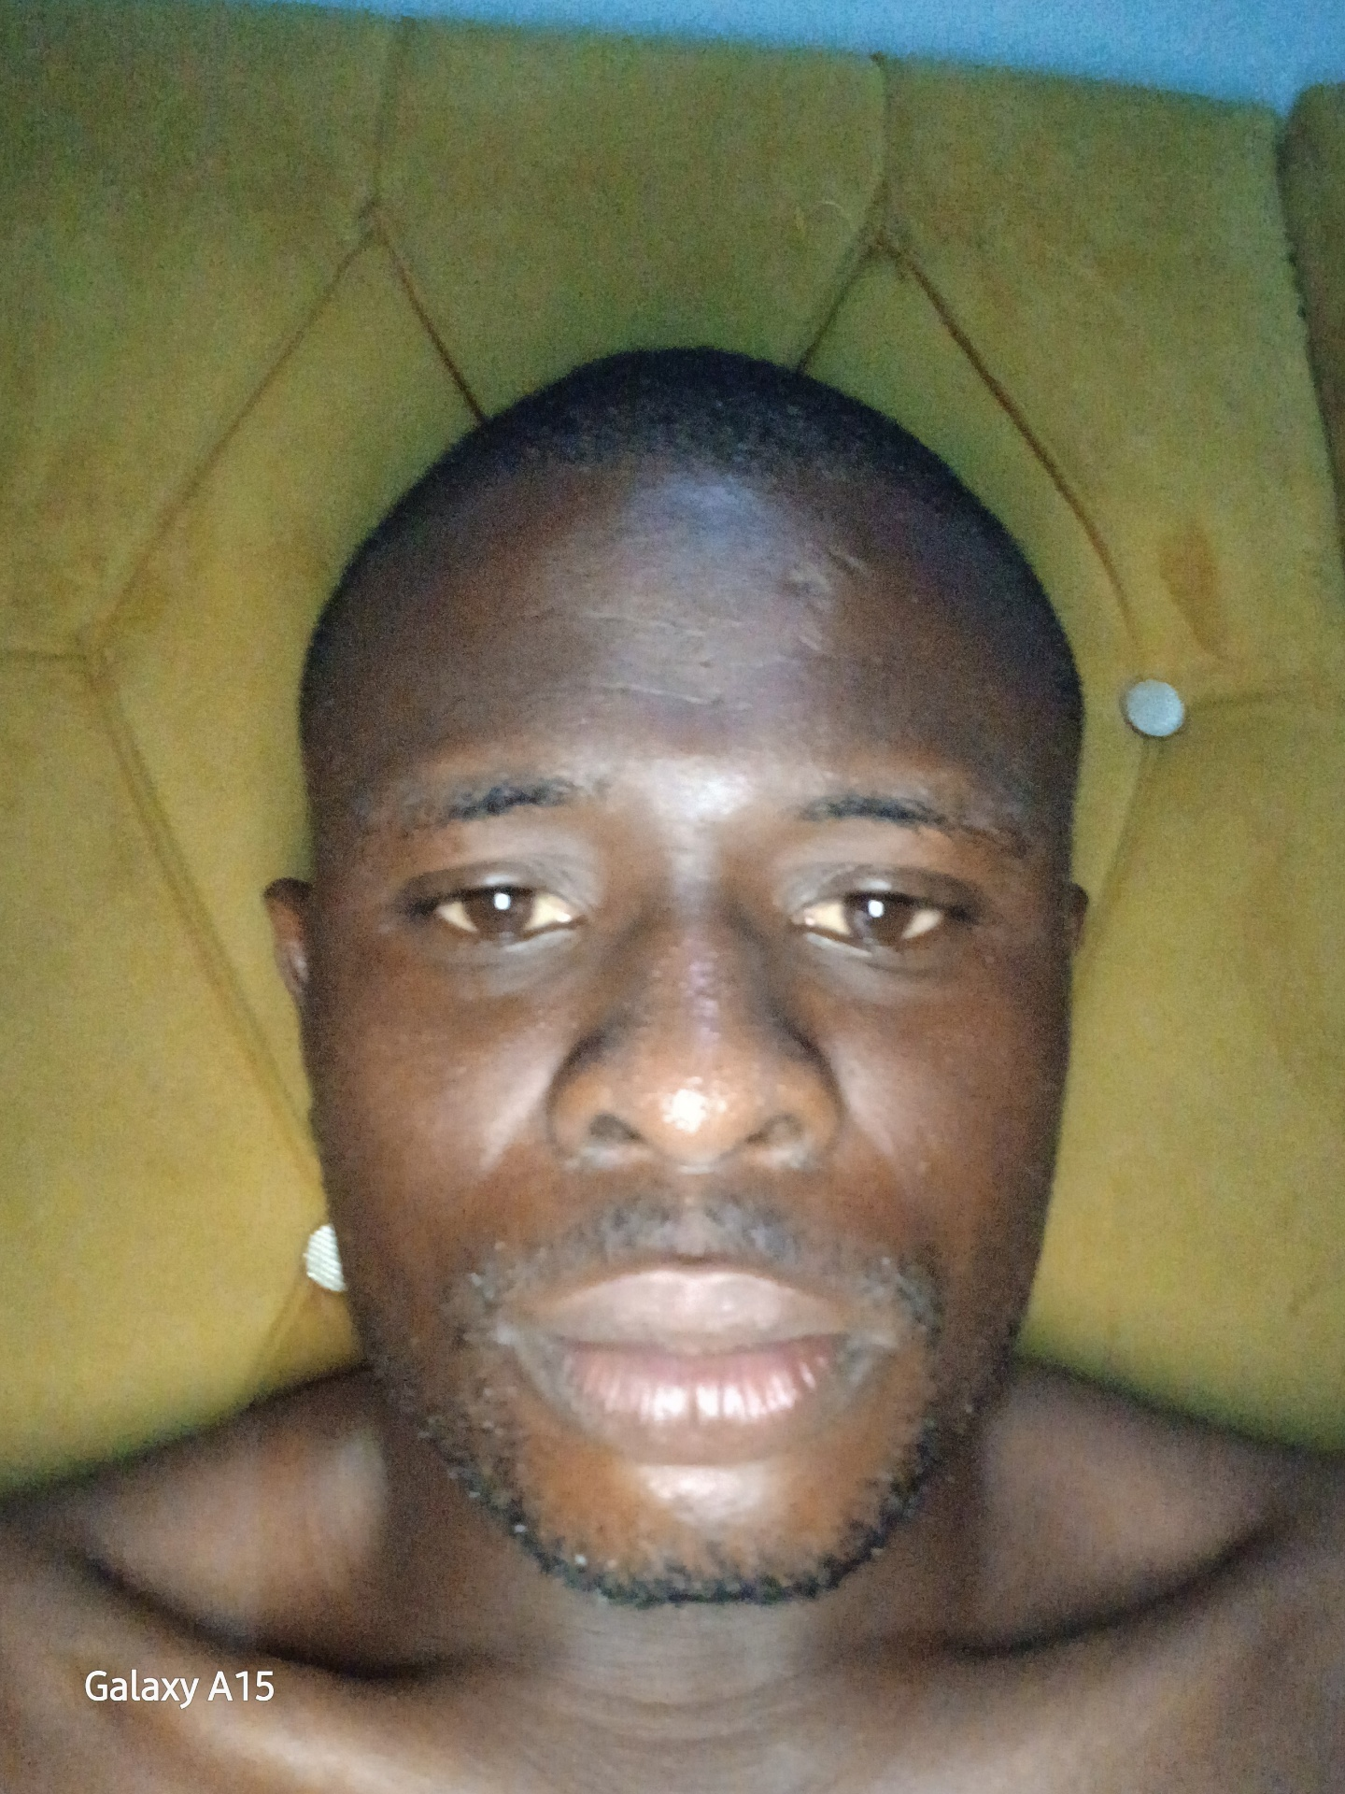
only, and thou shalt not be beneath; if that thou hearken unto the commandments of the LORD thy God, which I command thee this day, to observe and to do them:
And thou shalt not go aside from any of the words which I command thee this day, to the right hand, or to the left, to go after other gods to serve them.

Slide 5
2. Psalm 35 say:Plead my cause, O LORD, with them that strive with me: fight against them that fight against me.
Take hold of shield and buckler, and stand up for mine help.
Draw out also the spear, and stop the way against them that persecute me: say unto my soul, I am thy salvation.
Let them be confounded and put to shame that seek after my soul: let them be turned back and brought to confusion that devise my hurt.
Let them be as chaff before the wind: and let the angel of the LORD chase them.
Let their way be dark and slippery: and let the angel of the LORD persecute them.

Slide 6
For without cause have they hid for me their net in a pit, which without cause they have digged for my soul.
Let destruction come upon him at unawares; and let his net that he hath hid catch himself: into that very destruction let him fall.
And my soul shall be joyful in the LORD: it shall rejoice in his salvation.
All my bones shall say, LORD, who is like unto thee, which deliverest the poor from him that is too strong for him, yea, the poor and the needy from him that spoileth him?
False witnesses did rise up; they laid to my charge things that I knew not.

Slide 7
They rewarded me evil for good to the spoiling of my soul.
But as for me, when they were sick, my clothing was sackcloth: I humbled my soul with fasting; and my prayer returned into mine own bosom.
I behaved myself as though he had been my friend or brother: I bowed down heavily, as one that mourneth for his mother.
But in mine adversity they rejoiced, and gathered themselves together: yea, the abjects gathered themselves together against me, and I knew it not; they did tear me, and ceased not:
With hypocritical mockers in feasts, they gnashed upon me with their teeth.

Slide 8
Lord, how long wilt thou look on? rescue my soul from their destructions, my darling from the lions.
I will give thee thanks in the great congregation: I will praise thee among much people.
Let not them that are mine enemies wrongfully rejoice over me: neither let them wink with the eye that hate me without a cause.
For they speak not peace: but they devise deceitful matters against them that are quiet in the land.
Yea, they opened their mouth wide against me, and said, Aha, aha, our eye hath seen it.

Slide 9
This thou hast seen, O LORD: keep not silence: O Lord, be not far from me.
Stir up thyself, and awake to my judgment, even unto my cause, my God and my Lord.
Judge me, O LORD my God, according to thy righteousness; and let them not rejoice over me.
Let them not say in their hearts, Ah, so would we have it: let them not say, We have swallowed him up.
Let them be ashamed and brought to confusion together that rejoice at mine hurt: let them be clothed with shame and dishonour that magnify themselves against me.
Let them shout for joy, and be glad, that

Slide 10
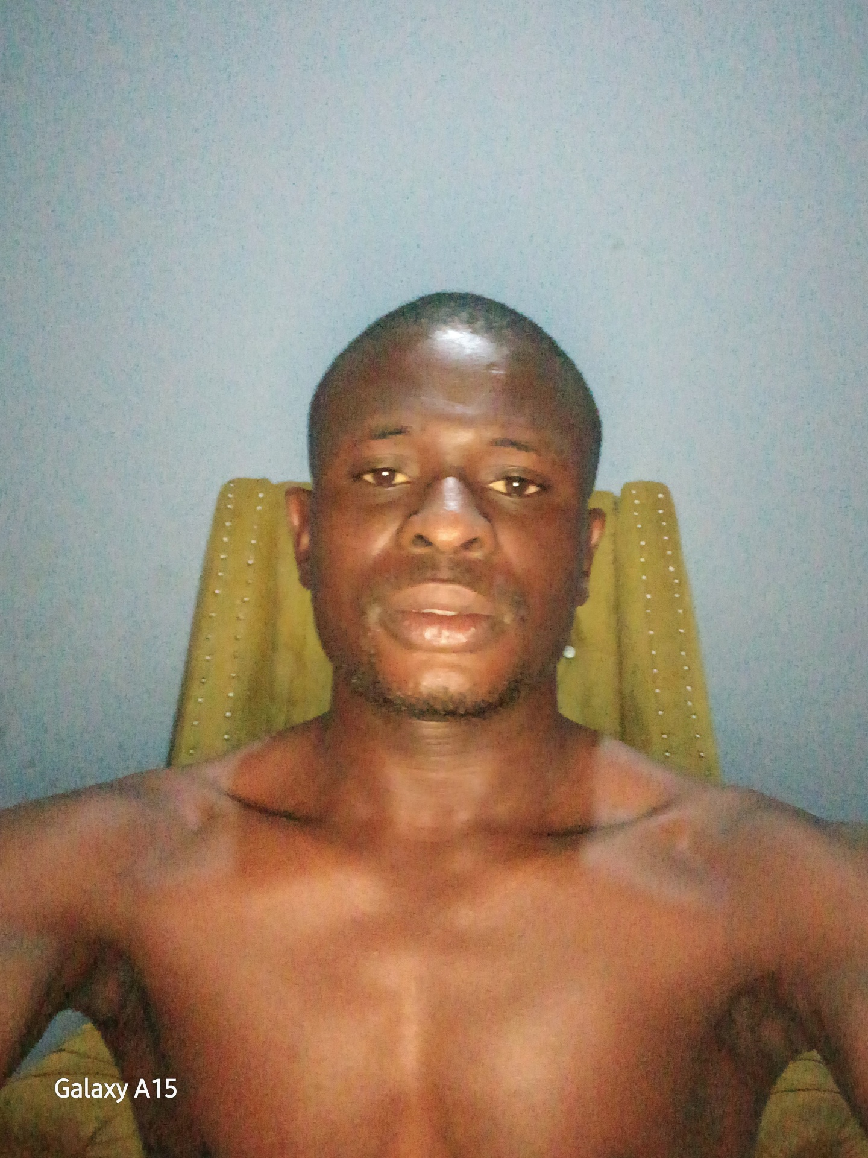
favour my righteous cause: yea, let them say continually, Let the LORD be magnified, which hath pleasure in the prosperity of his servant.
And my tongue shall speak of thy righteousness and of thy praise all the day long.

Slide 11
3. Psalm 40:11 to 16 say: Withhold not thou thy tender mercies from me, O LORD: let thy lovingkindness and thy truth continually preserve me.
For innumerable evils have compassed me about: mine iniquities have taken hold upon me, so that I am not able to look up; they are more than the hairs of mine head: therefore my heart faileth me.
Be pleased, O LORD, to deliver me: O LORD, make haste to help me.
Let them be ashamed and confounded together that seek after my soul to destroy it; let them be driven backward and put to shame that wish me evil.
Let them be desolate for a reward of their shame that say unto me, Aha, aha.

Slide 12
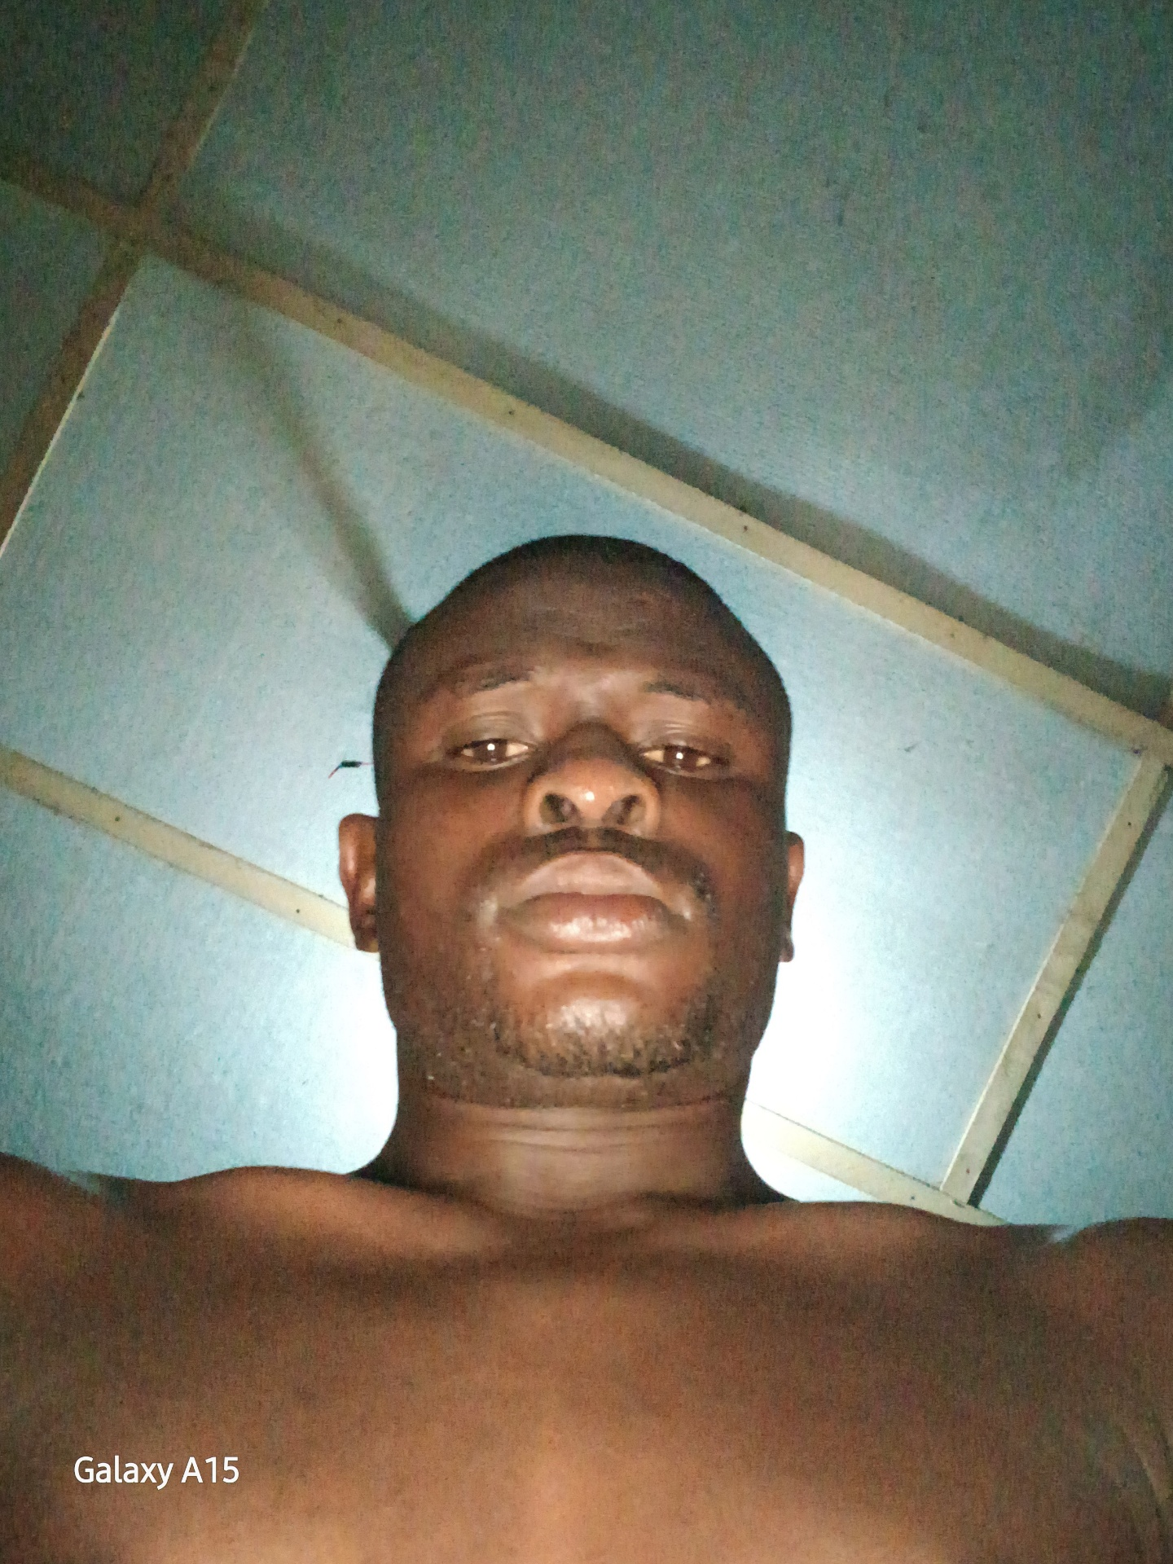
Let all those that seek thee rejoice and be glad in thee: let such as love thy salvation say continually, The LORD be magnified.
THANK YOU JESUS CHRIST SON OF LIVING GOD.
AMEN.

